Slide 1
ROCKBUSTER STEALTH LLC
2023 Presentation

Slide 2
Who is Rockbuster?
Rockbuster Stealth LLC is a movie rental company that used to have stores around the world. Facing stiff competition from streaming services such as Netflix and Amazon Prime, the Rockbuster Stealth management team is planning to use its existing movie licenses to launch an online video rental service in order to stay competitive.

Slide 3
INTERVAL TIME
Rental Duration
The average rental duration is 4.98 days.
Rental Rates
Minimum: $0.99
Maximum: $4.99
Average: $2.98
Replacement Cost
The average replacement cost per film is $19.98

Slide 4
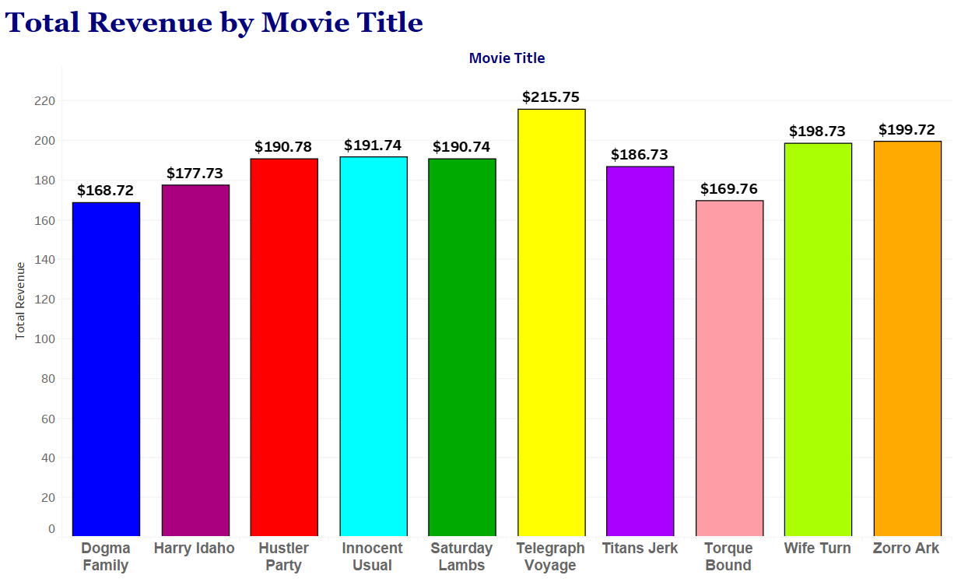
TOTAL REVENUE BY MOVIE TITLE

Slide 5
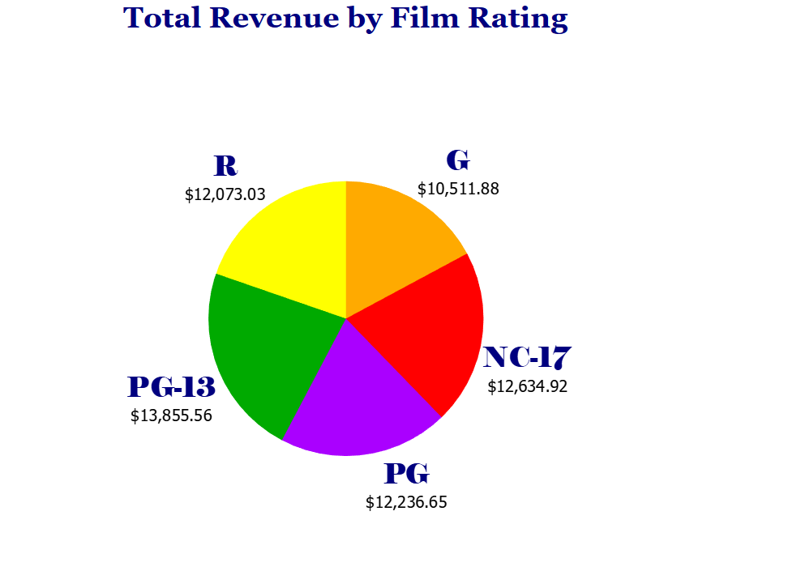
TOTAL REVENUE BY FILM RATING

Slide 6
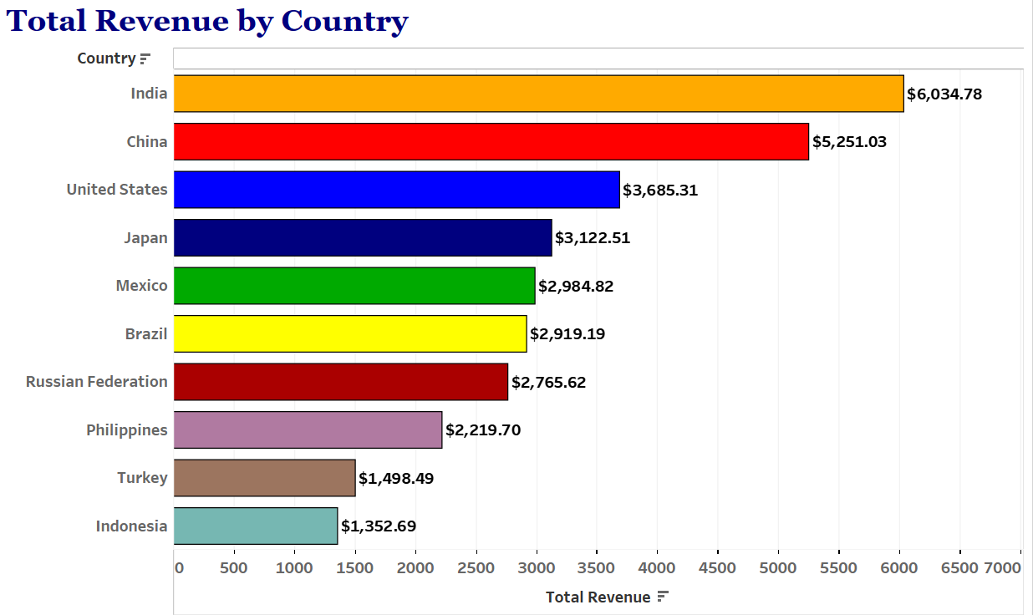
TOTAL REVENUE BY COUNTRY

Slide 7
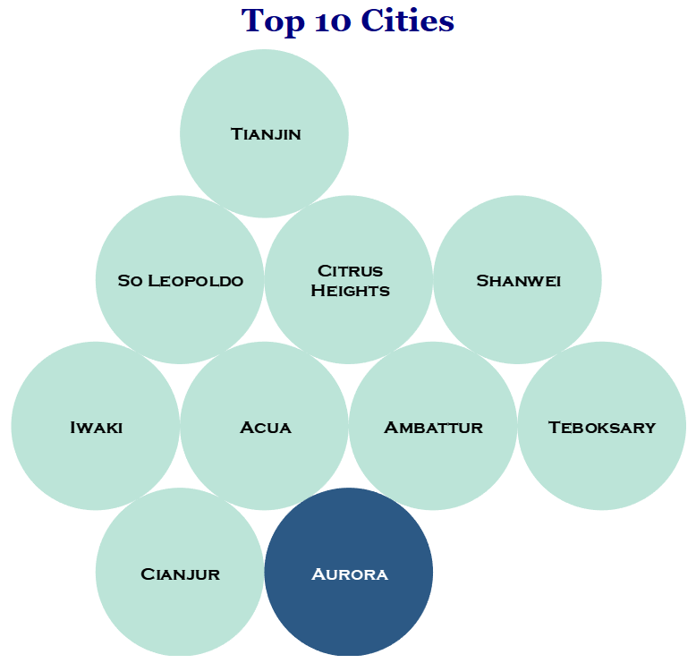

TOP 10 CITIES

Slide 8
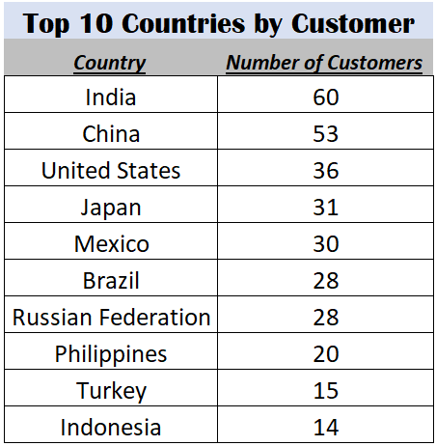
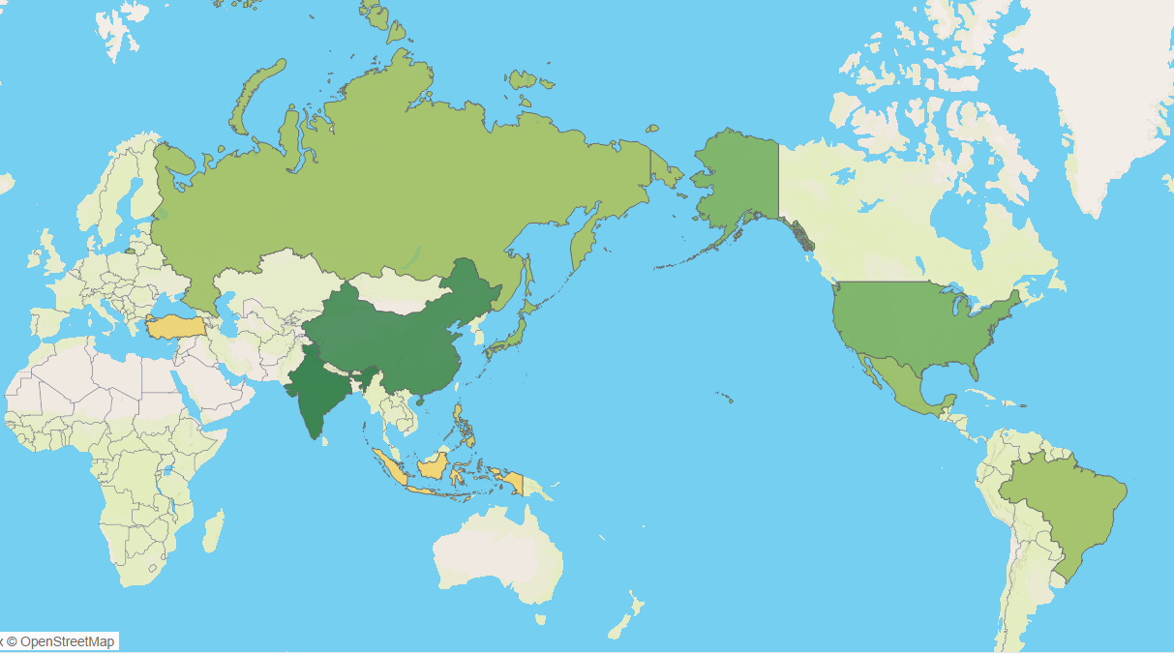
CUSTOMERS PER COUNTRY

Slide 9
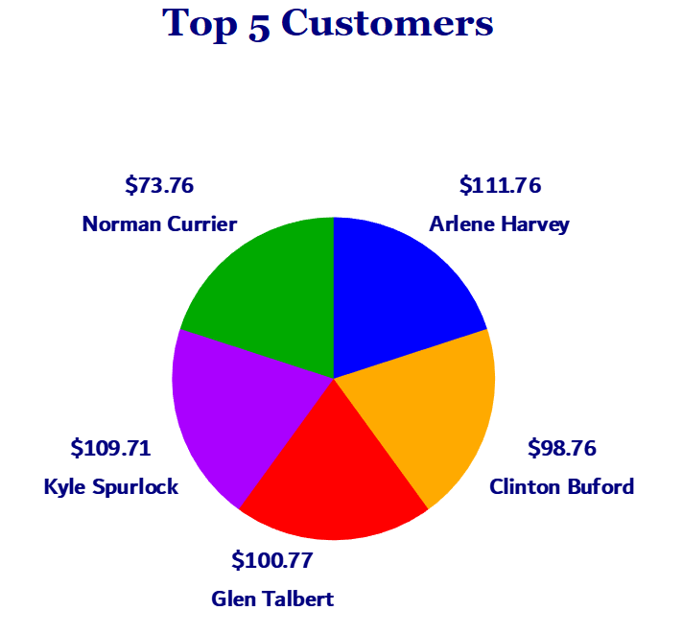

TOP 5 CUSTOMERS

